Slide 1

Deep Learning: Towards Deeper Understanding
Yuan YAO
HKUST

Slide 2
Acknowledgement
https://stats385.github.io/
http://cs231n.github.io/
A following-up course at HKUST that evolves every year:
https://deeplearning-math.github.io/

Slide 3
A Brief History of Neural Networks

Slide 4
Perceptron: single-layer

Slide 5
Hilbert’s 13th Problem

Slide 6
Kolmogorov’s Superposition Theorem
If f is a multivariate continuous function, then f can be written as a superposition of composite
functions of mixtures of continuous functions of single variables:
finite composition of continuous functions of a single variable and the addition.

Slide 7
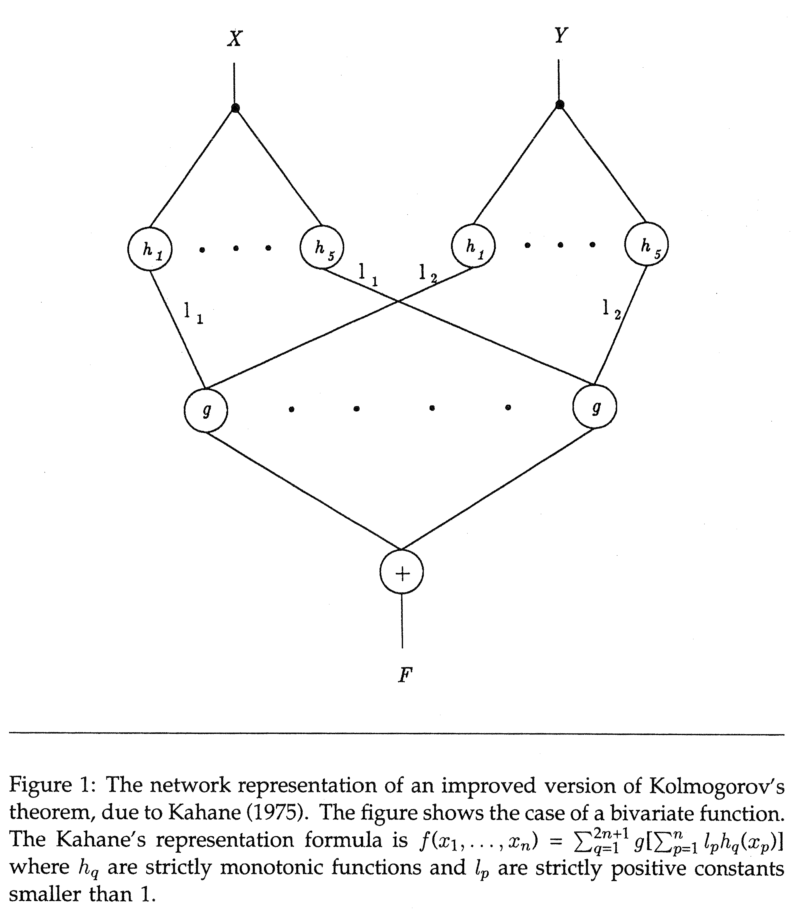
Kolmogorov’s Exact Representation is Irrelavant
[Girosi-Poggio’1989] Representation Properties of Networks: Kolmogorov’s Theorem Is Irrelevant, https://www.mitpressjournals.org/doi/pdf/10.1162/neco.1989.1.4.465
Lacking smoothness in h and g [Vitushkin’1964] fails to guarantee the generalization ability (stability) against noise and perturbations
The representation is not universal in the sense that g and h both depend on the function F to be represented.

Slide 8
A Simplified illustration by David McAllester

Slide 9
Universal Approximate Representation [Cybenko’1989, Hornik et al. 1989, Poggio-Girosi’1989, ...]
Complexity (regularity, smoothness) thereafter becomes the central pursuit in Approximation Theory.

Slide 10
The Perceptron Algorithm for classification
The Perceptron Algorithm is a Stochastic Gradient Descent method (Robbins-Monro 1951):

Slide 11
Finiteness of Stopping Time and Margin
Input ball:
Margin:

Slide 12
Locality or Sparsity of Computation
Minsky and Papert, 1969
Perceptron can’t do XOR classification
Perceptron needs infinite global information to compute connectivity
Locality or Sparsity is important:
Locality in time?
Locality in space?

Slide 13
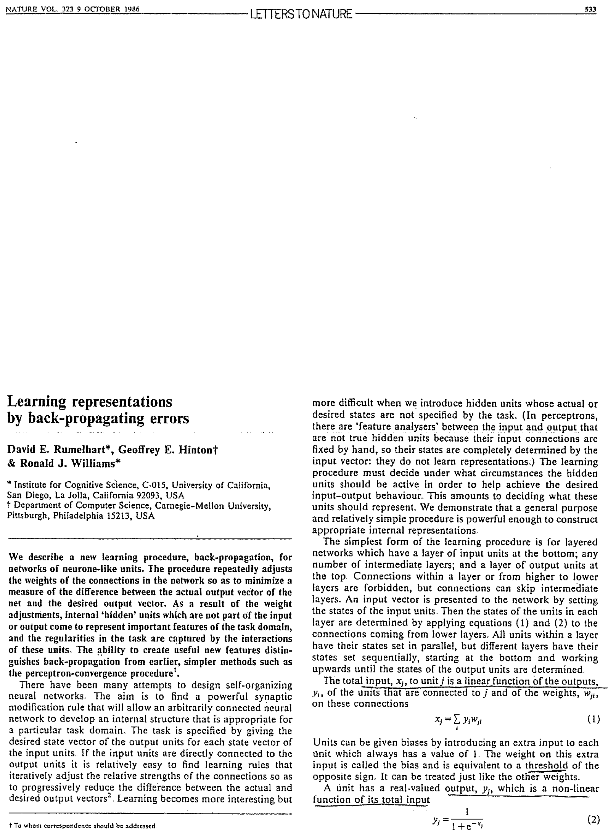
Multilayer Perceptrons (MLP) and Back-Propagation (BP) Algorithms
Rumelhart, Hinton, Williams (1986)
Learning representations by back-propagating errors, Nature, 323(9): 533-536
BP algorithms as stochastic gradient descent algorithms (Robbins–Monro 1950; Kiefer-Wolfowitz 1951) with Chain rules of Gradient maps
MLP classifies XOR, but the global hurdle on topology (connectivity) computation still exists: condition number in Blum-Shub-Smale real computation models helps.

Slide 14
BP Algorithm: Forward Pass

Slide 15
BP algorithm = Gradient Descent Method
Square loss, cross-entropy loss, etc.

Slide 16
Derivation of BP: Lagrangian Multiplier LeCun et al. 1988
http://yann.lecun.com/exdb/publis/pdf/lecun-88.pdf

Slide 18
Convolutional Neural Networks: shift invariances and locality

Slide 19
MNIST Dataset Test Error LeCun et al. 1998
Simple SVM performs as well as Multilayer Convolutional Neural Networks which need careful tuning (LeNets)
Dark era for NN: 1998-2012

Slide 20
Around the year of 2012: return of NN as `deep learning’
Speech Recognition: TIMIT
Computer Vision: ImageNet

Slide 21
Depth as function of year
ILSVRC ImageNet Top 5 errors

Slide 23
Deep Learning may be fragile in generalization against noise!

Slide 24

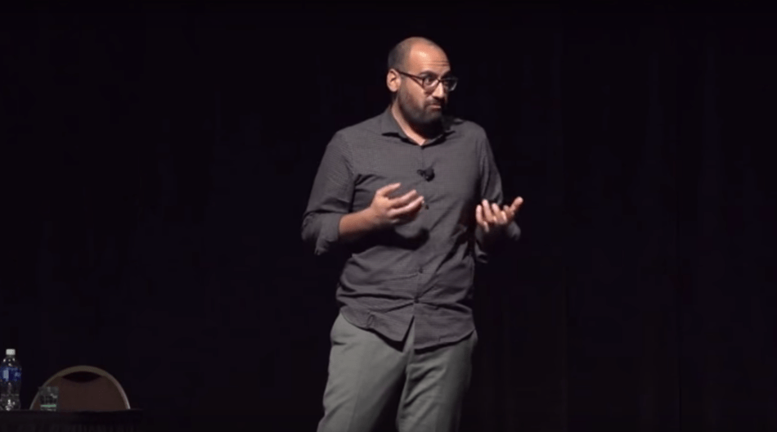
What’s wrong with deep learning?
Ali Rahimi NIPS’17: Machine (deep) Learning has become alchemy. https://www.youtube.com/watch?v=ORHFOnaEzPc
Yann LeCun CVPR’15, invited talk: What’s wrong with deep learning? One important piece: missing some theory (clarity in understanding)!
http://techtalks.tv/talks/whats-wrong-with-deep-learning/61639/
Being alchemy is certainly not a shame, not wanting to work on advancing to chemistry is a shame! -- by Eric Xing

Slide 25
What’s wrong with deep learning?
In this course, we only raise problems, and leave you to explore answers.

Slide 26
CNN learns texture features, not shapes
Geirhos et al. ICLR 2019
https://videoken.com/embed/W2HvLBMhCJQ?tocitem=46
1:16:47

Slide 27
Lack of Causality or Interpretability
ImageNet training learns non-semantic texture features: after random shuffling of patches, shapes information are destroyed which does not affect CNN’s performance much.
Zhanxing Zhu et al., ICML 2019

Slide 28
Capture spurious correlations and can’t do causal inference on counterfactuals
https://videoken.com/embed/8UxS4ls6g1g?tocitem=2
Leon Bottou, ICLR 2019

Slide 29
Deep learning is not robust -- adversarials are ubiquitous
[BCZOCG’18] Unrestricted Adversarial Example.

Slide 30
Overfitting causes privacy leakage
Model inversion attack leaks privacy
Fredrikson et al. Proc. CCS, 2016

Slide 31
Towards a deeper understanding of deep learning
How to achieve robustness?
Madry’s adversarial training, random smoothing, ensemble methods, stability regularization, etc.
How to guarantee privacy?
Differential privacy, model inversion privacy, membership privacy, etc.
How to improve interpretability or causality?
Invariance (learning), disentanglement of representation, etc.

Slide 32
Some Theories are limited but help:
Approximation Theory and Harmonic Analysis : What functions are represented well by deep neural networks, without suffering the curse of dimensionality and better than shallow networks?
Sparse (local), hierarchical (multiscale), compositional functions avoid the curse dimensionality
Group (translation, rotational, scaling, deformation) invariances achieved as depth grows
Statistics learning: How can deep learning generalize well without overfitting the noise?
“Benign overfitting”? …
Optimization: What is the landscape of the empirical risk and how to optimize it efficiently?
Wide networks may have simple landscape for GD/SGD algorithms …

Slide 33
Thank you!

Slide 34
Generalization Ability
Why over-parameterized models may generalize well without overfitting?

Slide 35
Generalization Error
Consider the empirical risk minimization under i.i.d. samples
The population risk with respect to unknown distribution
Fundamental Theorem of Machine Learning (for 0-1 misclassification loss, called ’errors’ below)

Slide 36
Why big models generalize well?
Ben Recht et al. 2016

Slide 37
The Bias-Variance Tradeoff?

Slide 38
Over-parameterized models
As model complexity grows (p>n), training error goes down to zero, but test error does not increase. Why overparameterized models do not overfit here? -- Tommy Poggio, 2018

Slide 39
Some tentative answers:
Belkin et al.: Interplolation (overfitting) has a low generalization error in overparameterization regime
https://simons.berkeley.edu/talks/tbd-65
For overparameterized linear regression models:
Peter Bartlett et al. https://simons.berkeley.edu/talks/tbd-51
Trevor Hastie et al. asymptotic theory based on random matrix theory
For logistic regressions:
Telgarsky, Srebro, et al. GD converges to max margin solution
Nonlinear neural networks: ???
Some warnings on “interpolations”:
Ben Recht: https://simons.berkeley.edu/talks/tbd-63

Slide 40
Yet, Overfitting indeed hurts…
Lack of Robustness
Courtesy of Dr. Hongyang ZHANG.

